Slide 1
Government & Comparative Politics
The approach and methods of comparative politics
IE University
Spring 2023
Prof. Guillermo Toral

Slide 2
What we’ll cover today
Housekeeping
Quiz
Lecture & exercises:
What is comparative politics?
Why is comparative politics useful?
How do we learn in comparative politics?
Workshop: How to read a political science article

Slide 3
What we’ll cover today
Housekeeping
Quiz
Lecture & exercises:
What is comparative politics?
Why is comparative politics useful?
How do we learn in comparative politics?
Workshop: How to read a political science article

Slide 4

Register your attendance

Slide 5
Quiz grade policy
At the end of the semester, and before computing your final overall grade for the course, I will drop your lowest quiz score.
If you miss more than one quiz, then you will get a 0 that will count toward your final quiz grade
Still, every individual quiz is worth less than 1.5% of your grade

Slide 6
What we’ll cover today
Housekeeping
Quiz
Lecture & exercises:
What is comparative politics?
Why is comparative politics useful?
How do we learn in comparative politics?
Workshop: How to read a political science article

Slide 7
Quiz
Rules
8 minutes limit (responses automatically saved)
Respondus
No other screens allowed
No communication with others (through any means) allowed
But you CAN check your notes, as long as they are on paper (handwritten or printed)
You can find the quiz on Blackboard, under today’s session
Access code: 168104

Slide 8
What we’ll cover today
Housekeeping
Quiz
Lecture & exercises:
What is comparative politics?
Why is comparative politics useful?
How do we learn in comparative politics?
Workshop: How to read a political science article

Slide 9
What is NOT comparative politics?
International relations
Political philosophy
Exclusively dedicated to:
National-level politics
Macro-level phenomena
Formal institutions
Interested in individual cases in and of themselves
Political commentary

Slide 10
What IS comparative politics?
A subfield of political science preoccupied with the causes and consequences of different aspects of political systems
A scientific enterprise, leveraging clear theory and credible empirical strategies to learn about general political phenomena (and not just individual cases)
An active field of research, leveraging a diversity of theoretical models and empirical methods, applied to data anywhere in the world or throughout history

Slide 11
Where do you find comparative politics?
The frontier knowledge on comparative politics is produced in universities, published first as working papers and then in top, peer-reviewed, academic journals. Some work is eventually published as academic, peer-reviewed books.
That knowledge is often (but not always) distilled to the broader in public in the form of policy reports, media reports, newspaper columns, podcasts, media appearances
Good comparative politics research manages to shape elite decisions, public debates, and/or policymaking processes

Slide 12

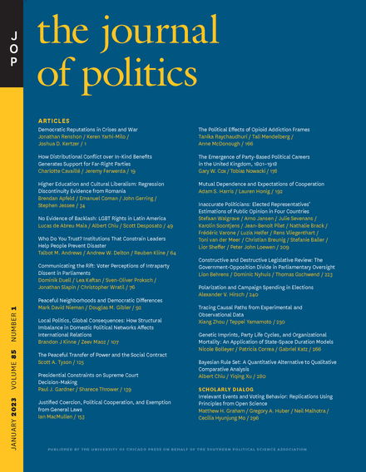
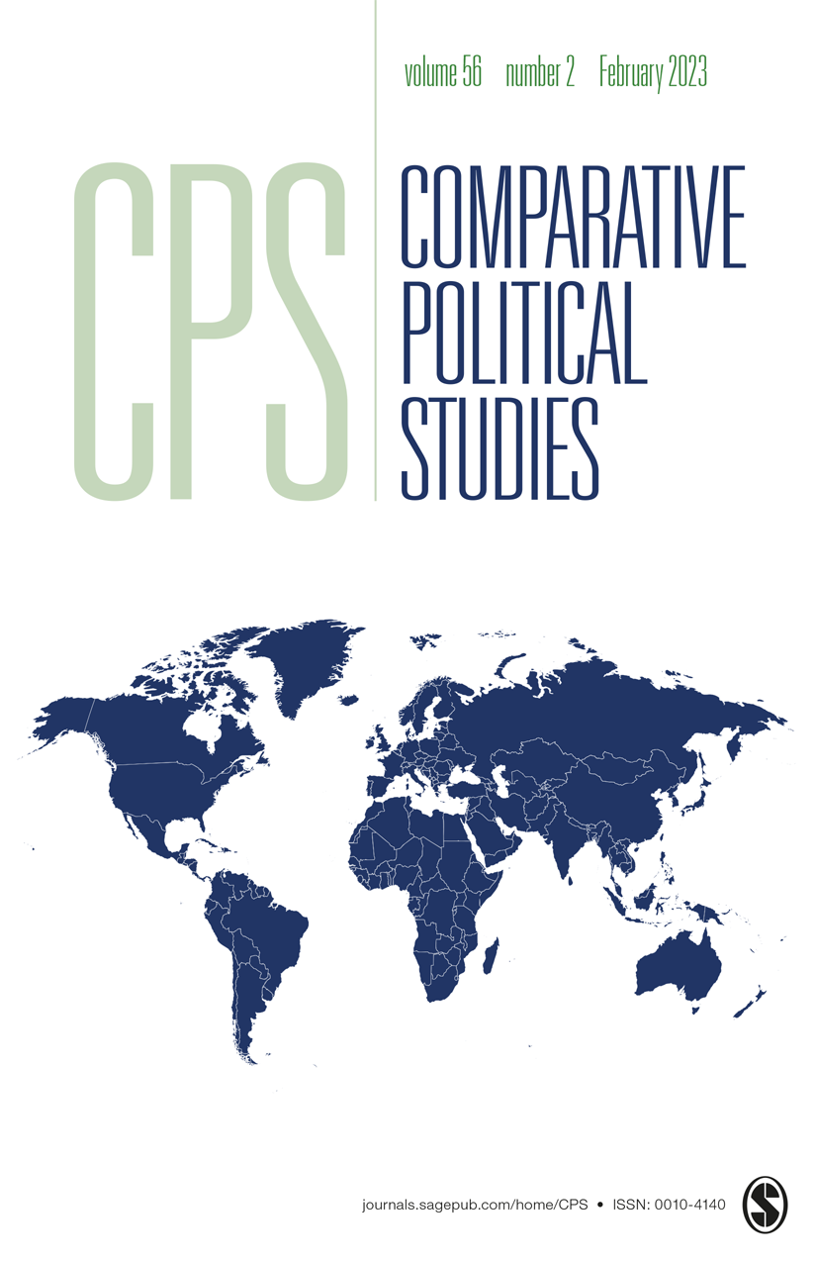
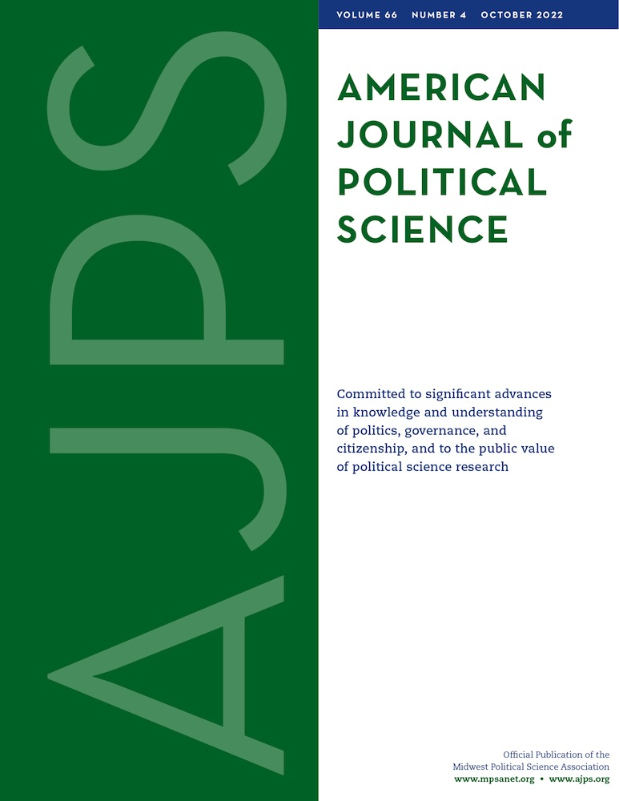
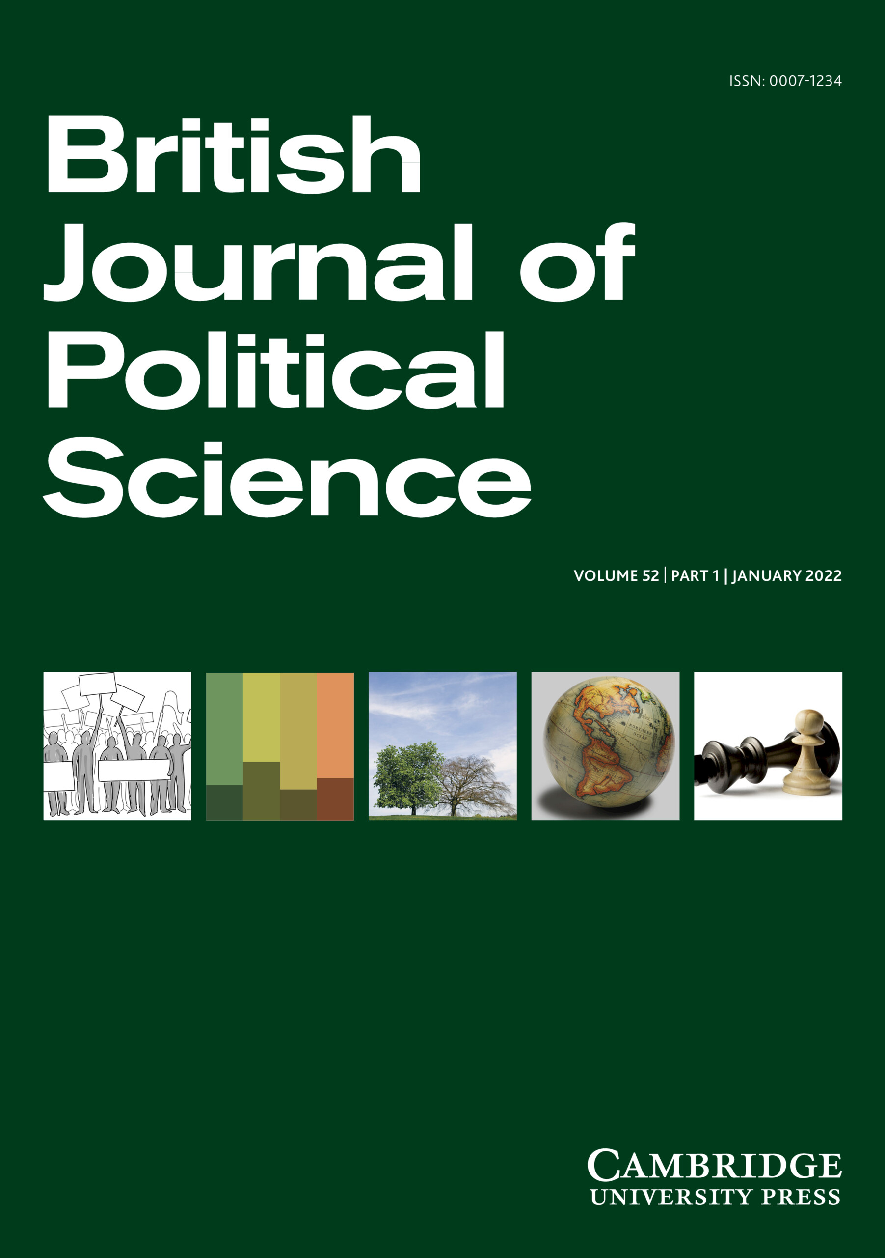
Where do you find comparative politics?

Slide 13
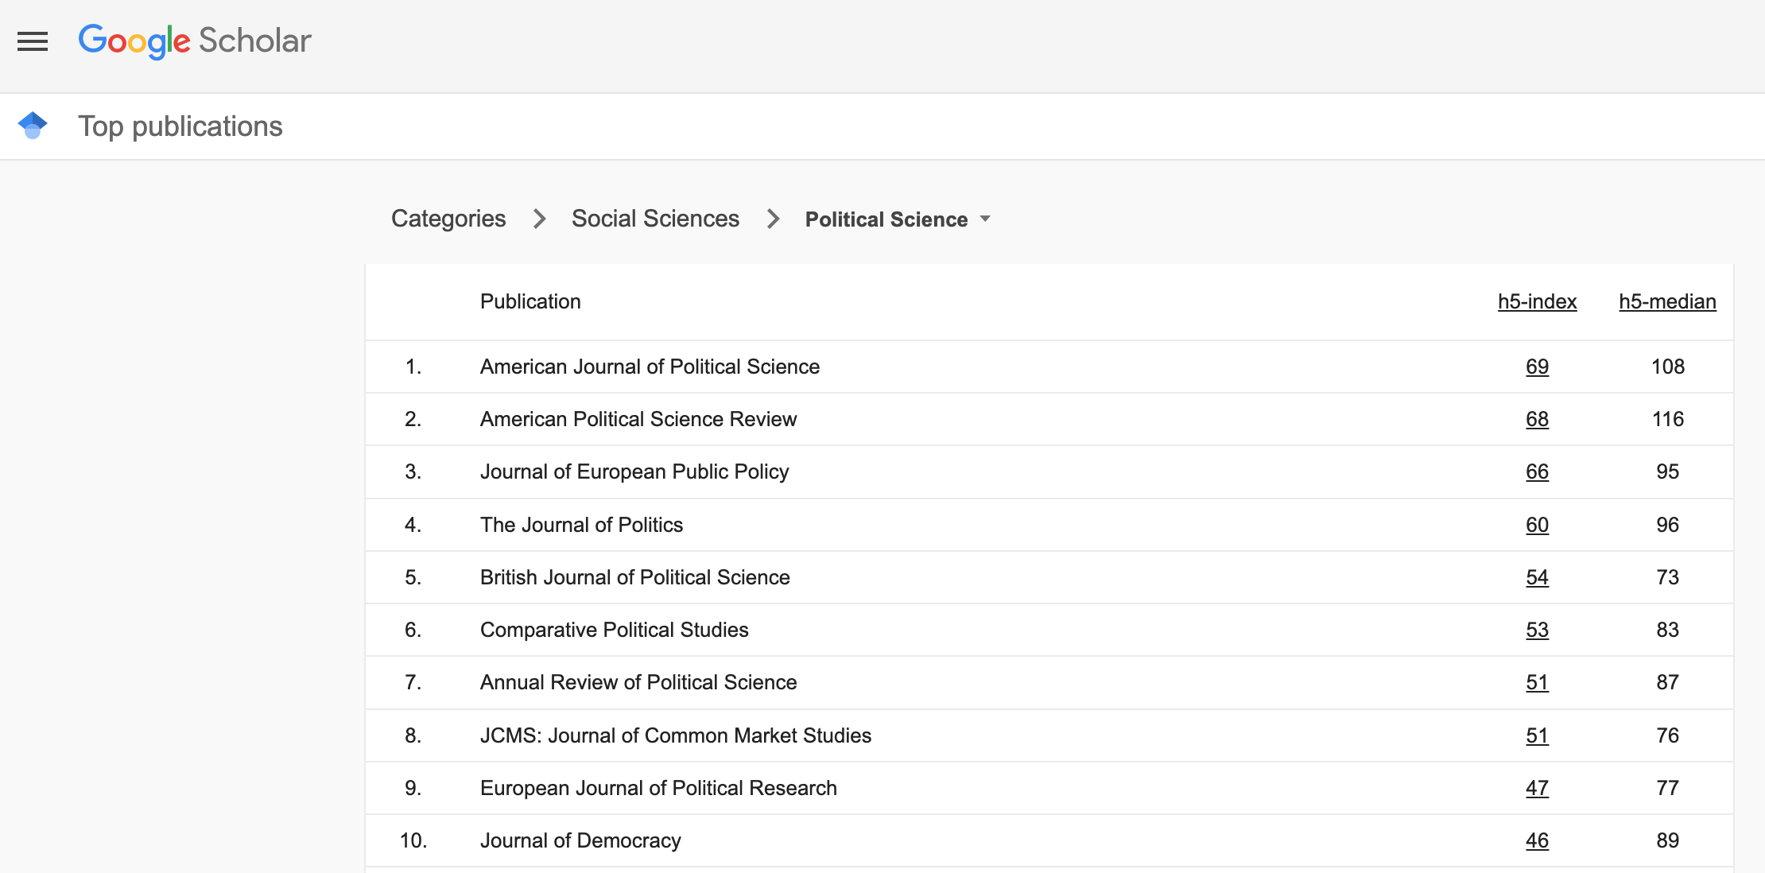
Where do you find comparative politics?

Slide 14
What we’ll cover today
Housekeeping
Quiz
Lecture & exercises:
What is comparative politics?
Why is comparative politics useful?
How do we learn in comparative politics?
Workshop: How to read a political science article

Slide 15
Is comparative politics useful? Why? For whom?
CP for political consulting
CP for political commentary
CP for policy making
CP for business opportunities
CP for civic education

Slide 16
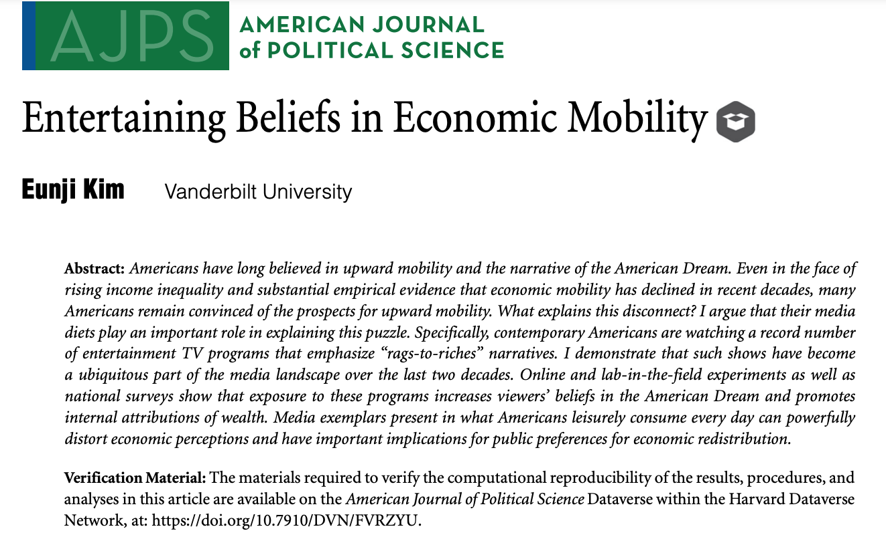
Is this study useful? Why? For whom?

Slide 17
What we’ll cover today
Housekeeping
Quiz
Lecture & exercises:
What is comparative politics?
Why is comparative politics useful?
How do we learn in comparative politics? – Theory
Workshop: How to read a political science article

Slide 18
Different types of arguments
Normative
Descriptive
Predictive
Causal

Slide 19
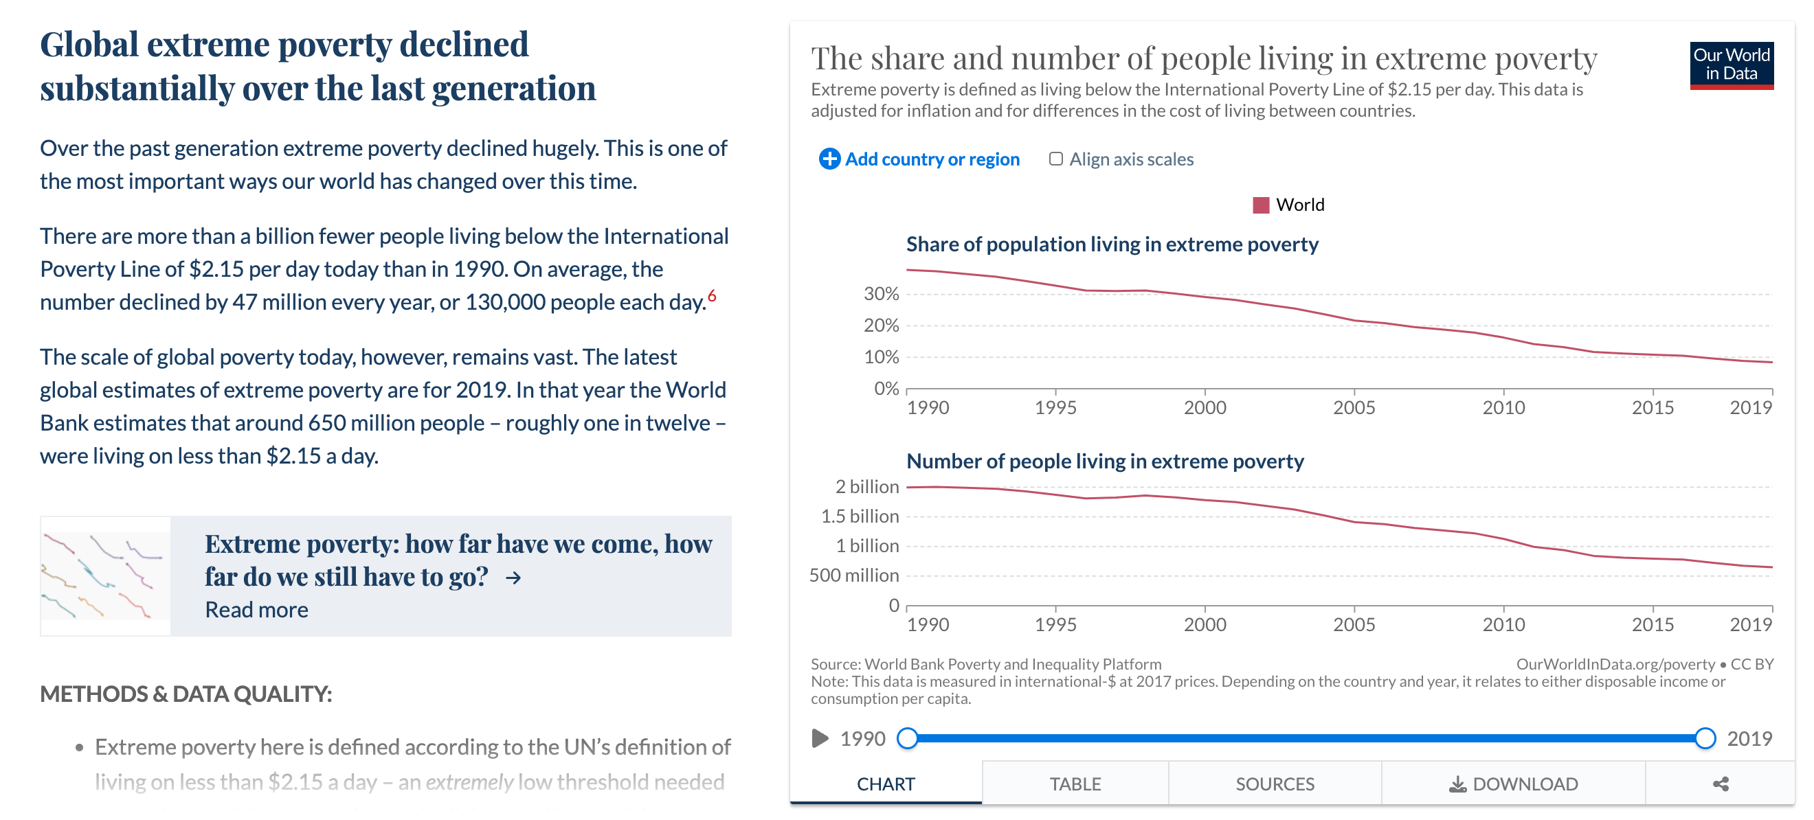
What kind of argument is this?

Slide 20
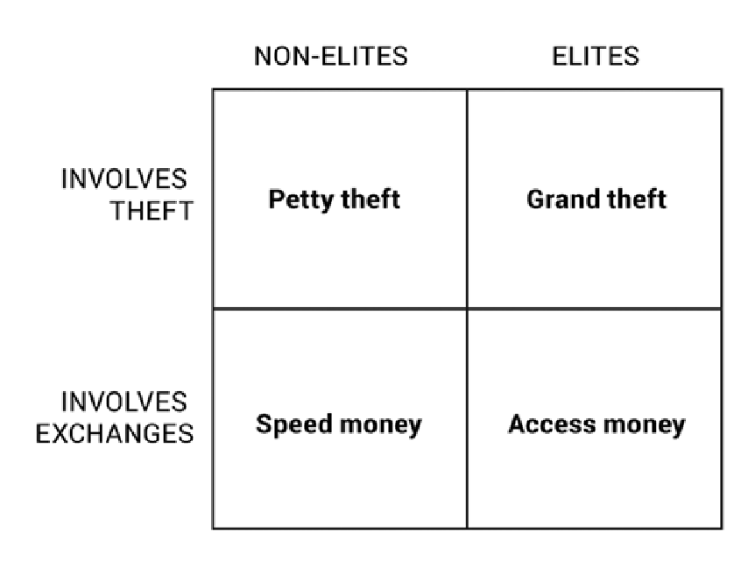
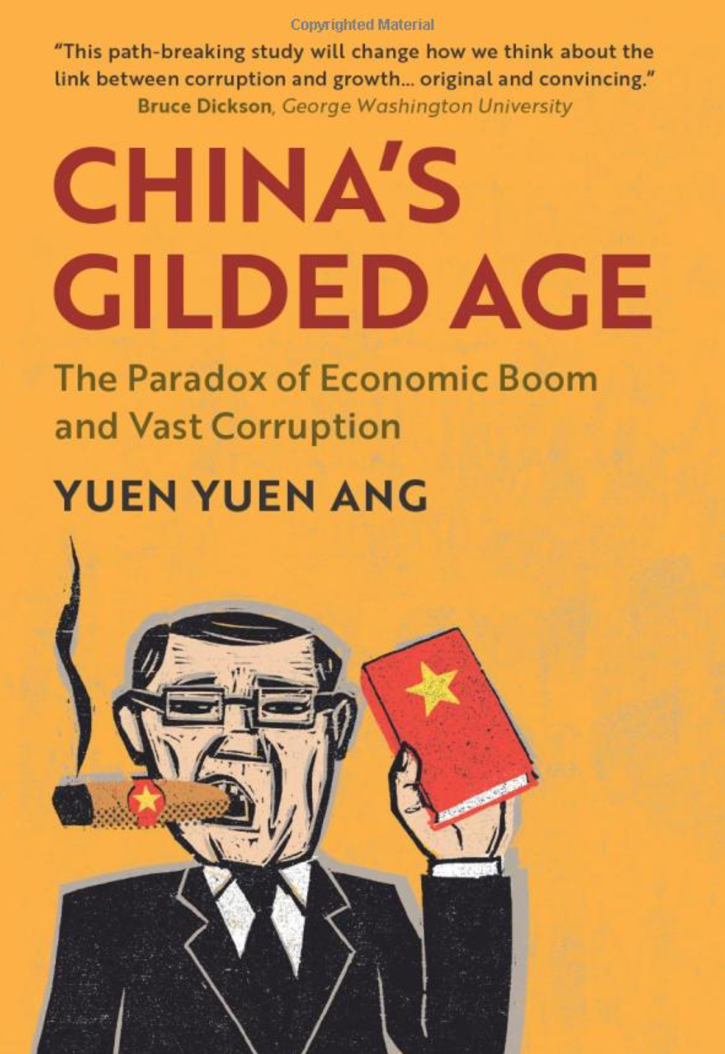
What kind of argument is this?

Slide 21
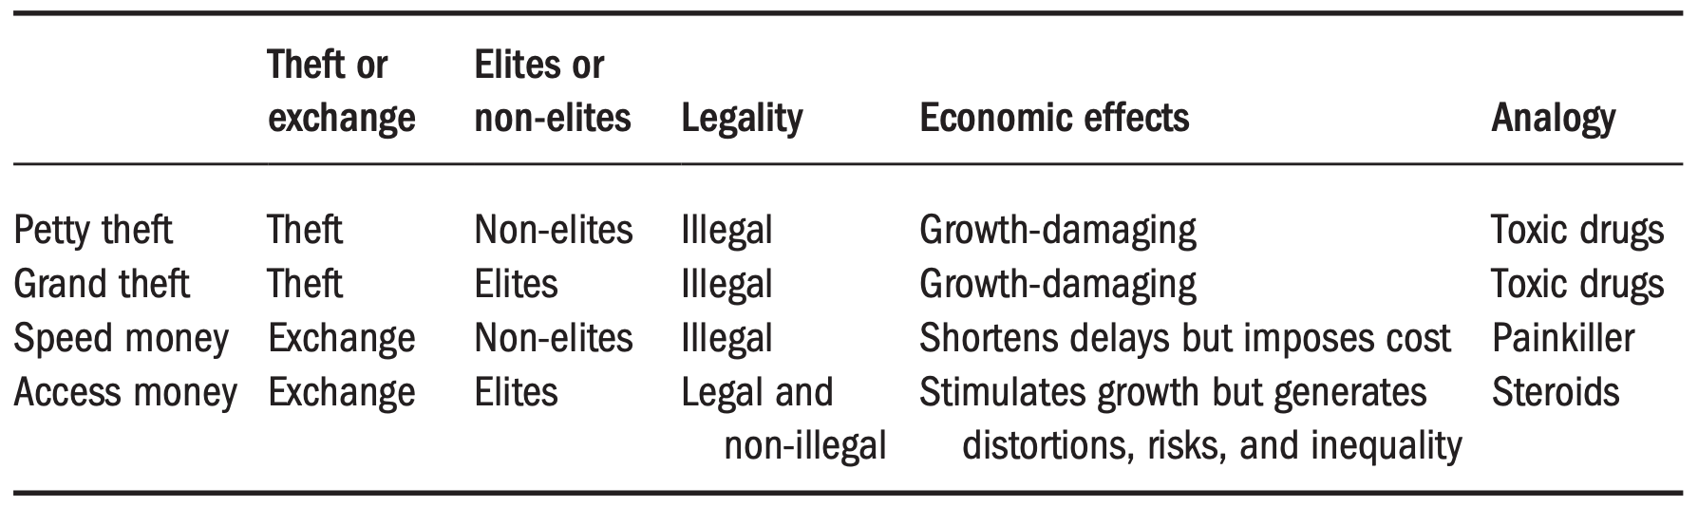
What kind of argument is this?

Slide 22
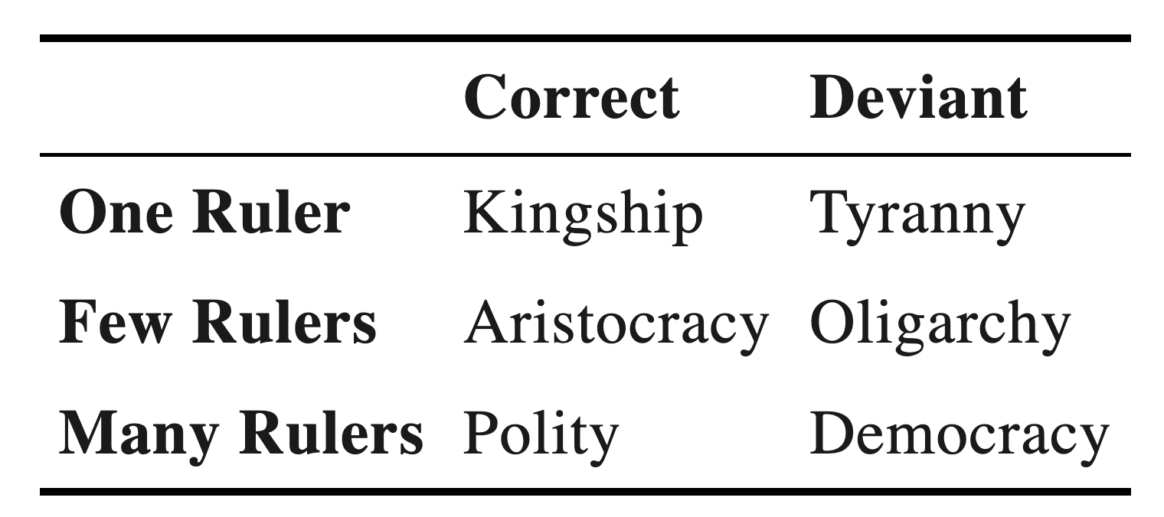
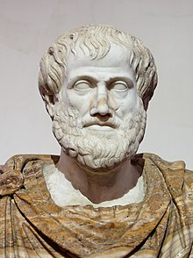
What kind of argument is this?

Slide 23
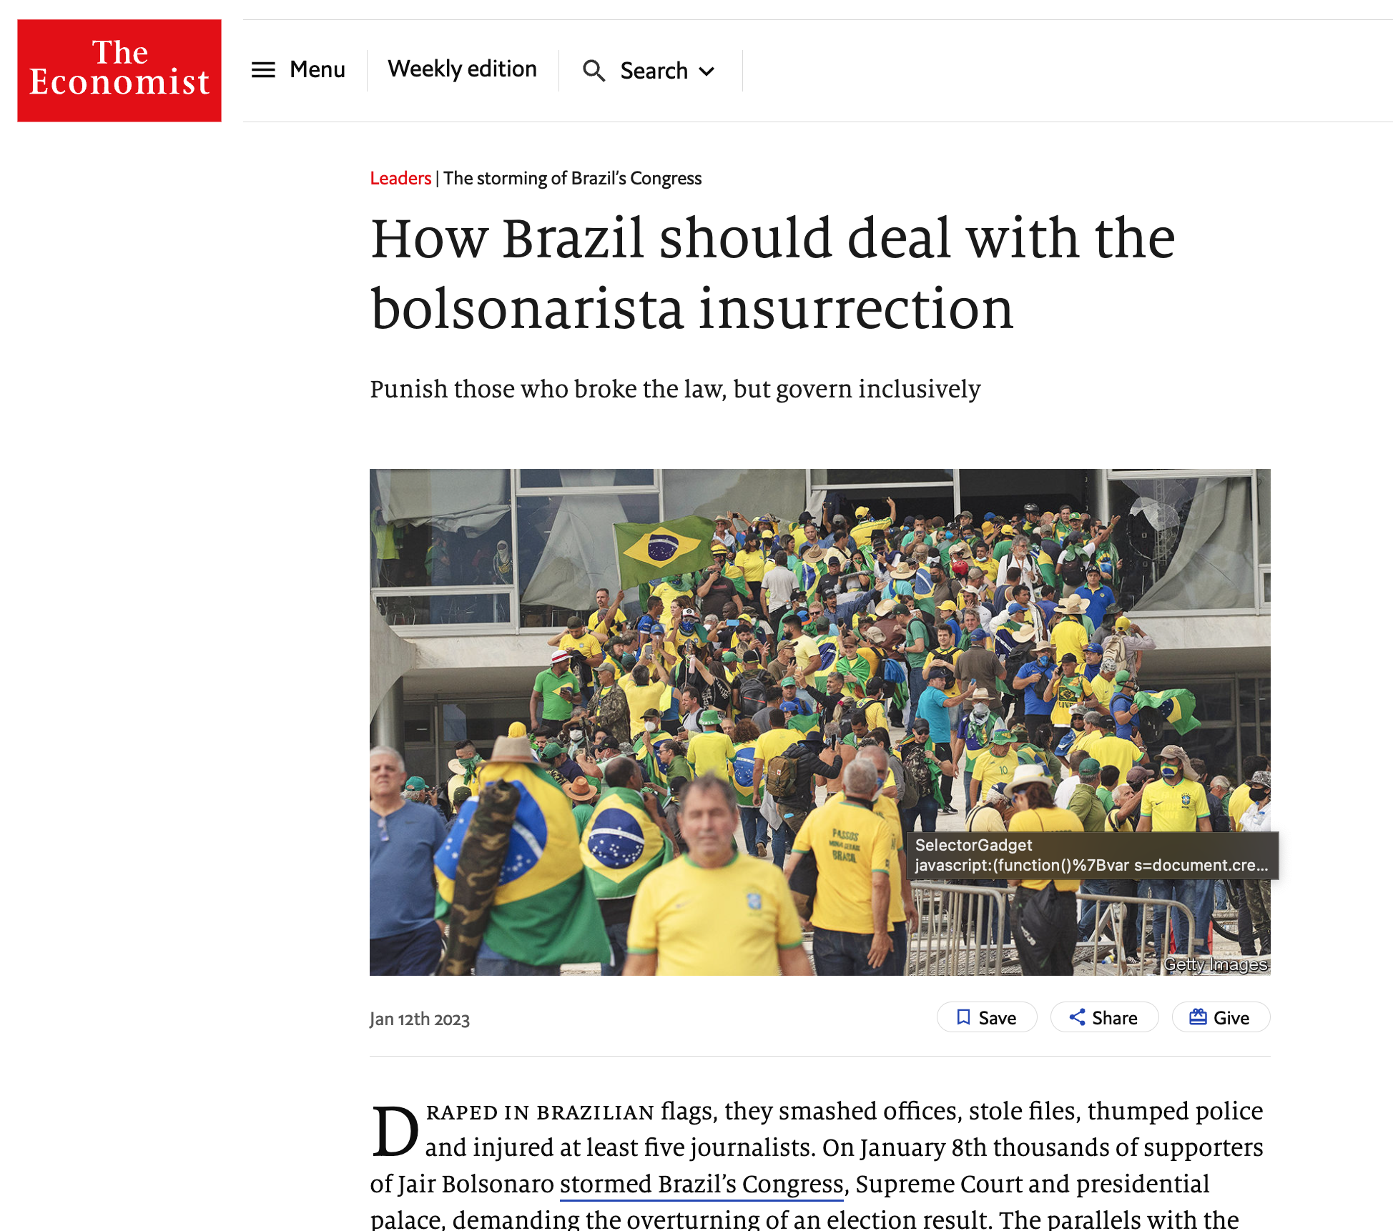
What kind of argument is this?

Slide 24
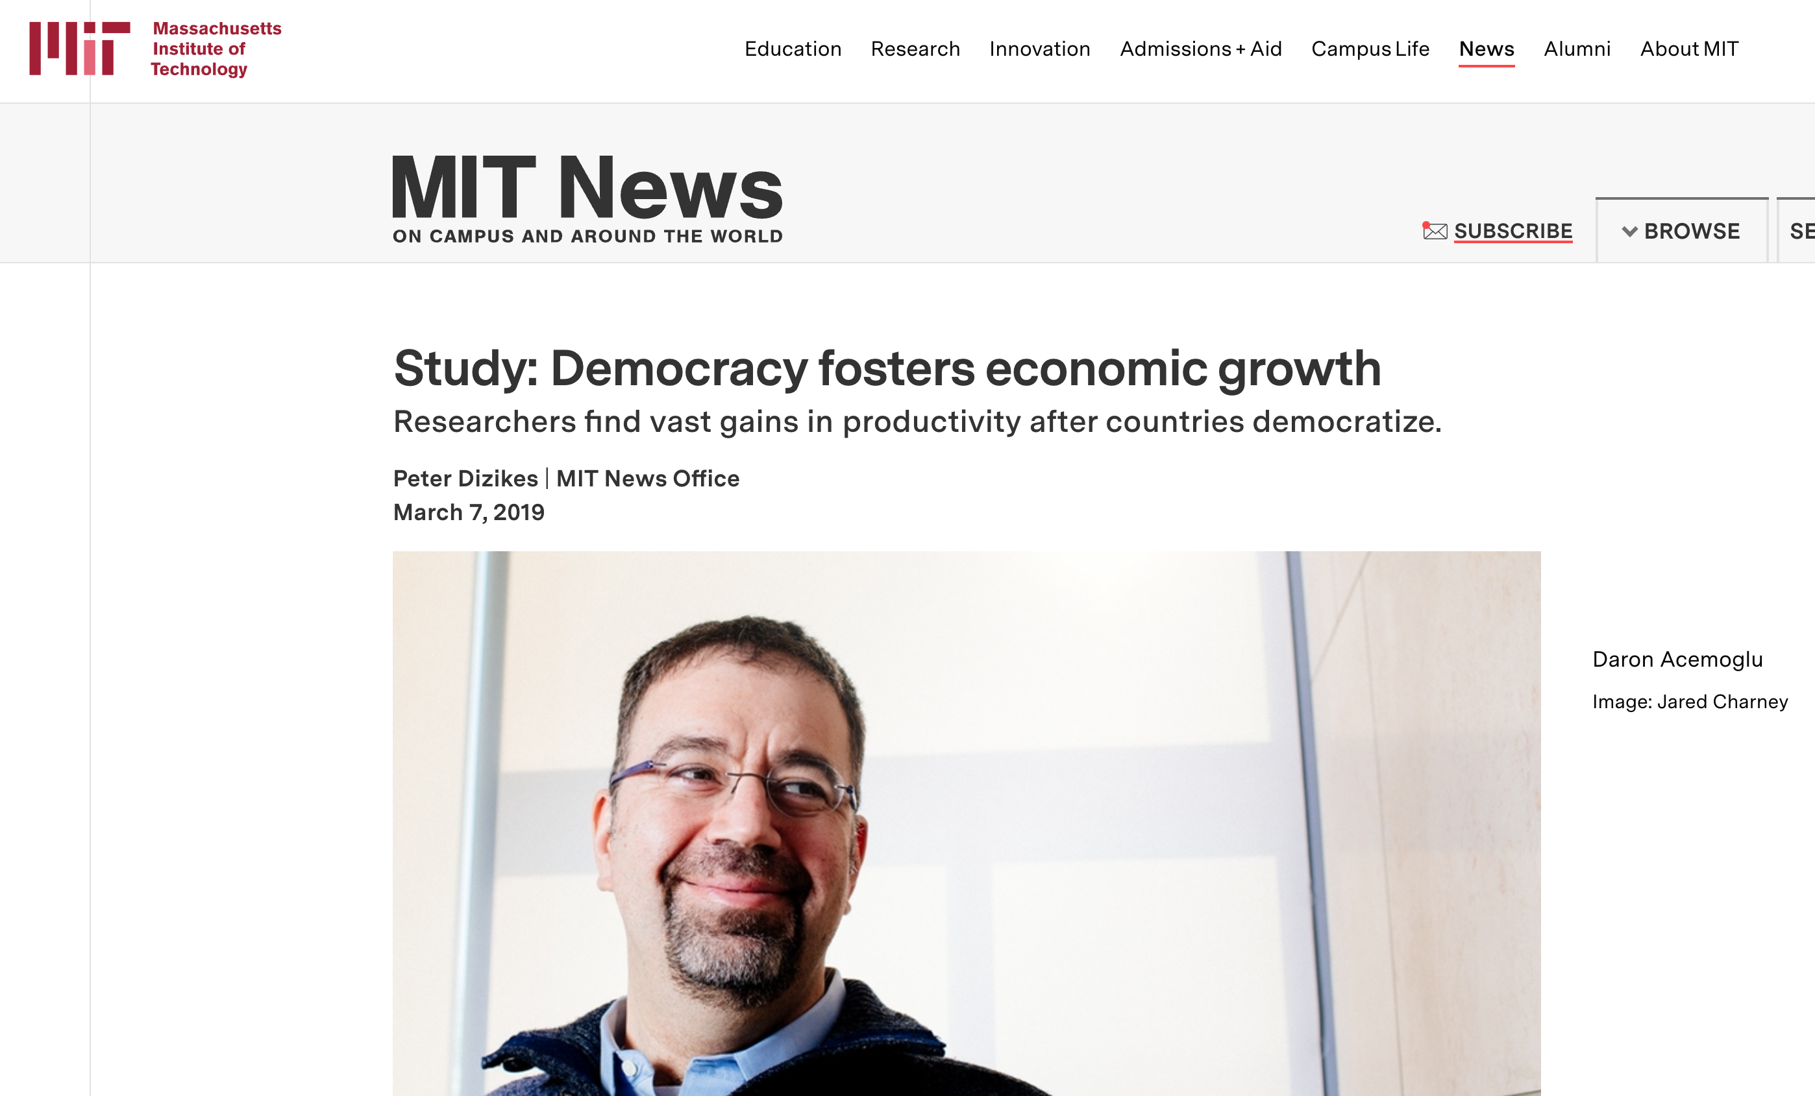
What kind of argument is this?

Slide 25
What kind of argument is this?

Slide 26
Different types of arguments: How are they assessed?
Normative arguments typically assessed by their values, their internal coherence, and their relationship not to data but to ideas
Descriptive arguments typically assessed by their ability to cover and organize an empirical reality
Predictive arguments typically assessed by their ability to predict the future or out-of-sample cases
Causal arguments typically assessed by their capacity to explain the drivers of a phenomenon or the consequence of another phenomenon
Causality is intimately linked to our capacity to change the world
Learning about the causal effect of X on Y gets us closer to being able to change Y

Slide 27
What is a theory (in CP)?
A proposition or set of propositions about the relationship between variables, providing an internally consistent logic to explain (political) phenomena, and which can be subjected to empirical testing through observation or experimentation
A good theory:
has some generality
is phrased independently of the empirical cases used to build or test it
specifies any relevant mechanisms (or channels through which variables are connected)
specifies any relevant scope conditions (or where / when it should apply)

Slide 28
How are theories useful?
To simplify reality by identifying the most important sources of variation and relationships among them
To frame empirical puzzles
To derive empirically testable hypotheses
To guide research design (case selection, measurement, comparison)
To focus and structure our comparisons
To guide observation and further theory development

Slide 29
Key elements in a (simple) theory
A dependent variable (Y)
An independent variable (X)
A hypothesis about the causal connection between the two (e.g., X → Y)
A causal story about how they are connected (e.g., X → Z → Y)

Slide 30
What are the key elements of Kim’s theory?
Dependent variable
Independent variable
Hypothesis about causal connection
Causal story about mechanisms

Slide 31
What we’ll cover today
Housekeeping
Quiz
Lecture & exercises:
What is comparative politics?
Why is comparative politics useful?
How do we learn in comparative politics? – Research design
Workshop: How to read a political science article

Slide 32
What is a research design (in CP)?
A strategy for answering a research question using empirical material
A good research design:
produces internally valid conclusions
gives us a sense of uncertainty around those conclusions
has some degree of external validity

Slide 33
How are research designs useful?
To specify a credible way to test a theory
To bridge the gap between abstract theories and specific cases
To enable others in the scientific community or the public at large to re-assess the validity of our conclusions
To bolster the credibility of a theory
To allow for theoretical refinement

Slide 34
Key elements of a research design
A set of cases
A comparison
A way of making inferences (typically about causal effects)
A way of measuring our uncertainty around such inferences
A rationale (and supporting evidence) why the comparison we make gets at the key relationship we are interested in, and is not contaminated by other factors

Slide 35
The importance of “ceteris paribus”
If we want to learn about the effect of X on Y, typically looking at the level of Y among units (countries / cities / individuals) with high vs low levels of X won’t be a valid strategy.
That is because social and political variables of interest are typically correlated with many other variables – units with high levels of X (and Y) may in average also have high levels of Z
We typically want to argue that a relationship between X and Y holds ”ceteris paribus” or “all other things being equal” – but how can we say that credibly?

Slide 36
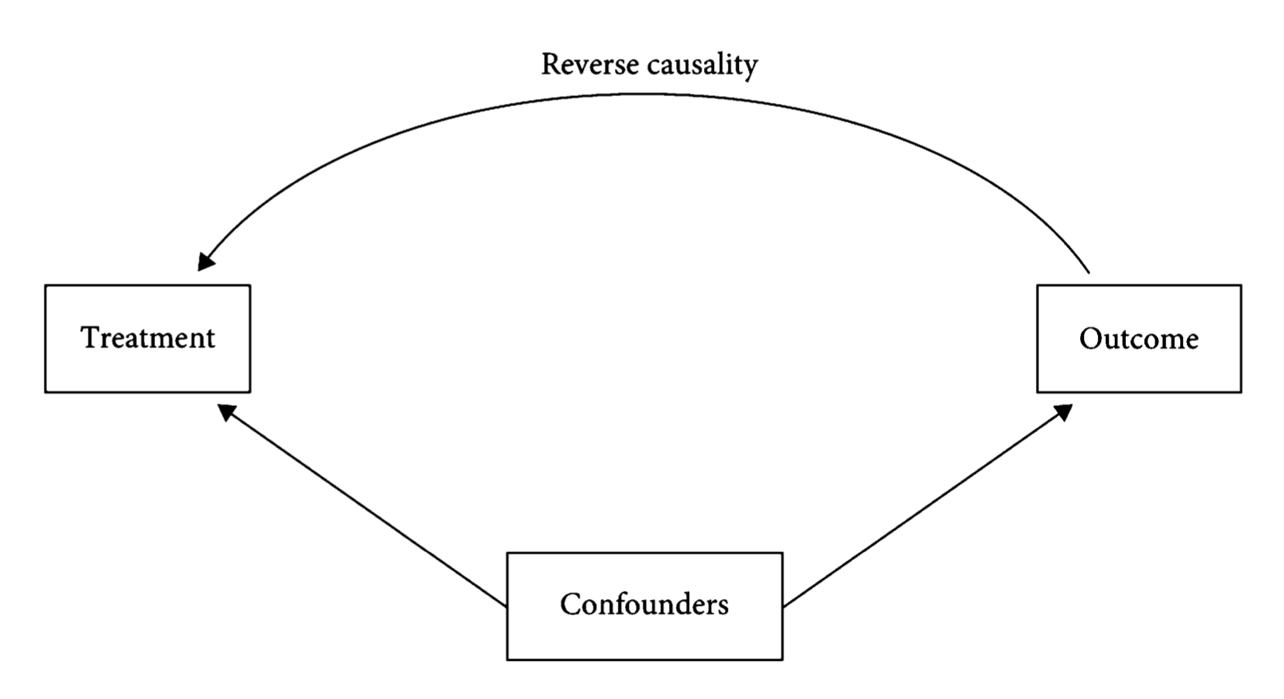
The key obstacles to “ceteris paribus”

Slide 37
Empirical material
Case studies
Interviews
Surveys
Big (administrative) data
Lab or field experiments
Etc.

Slide 38
Empirical strategies to get at “ceteris paribus”
Process tracing
Controlled case comparisons
Statistical models with controls
Quasi-experiments
Experiments
Experiments & quasi-experiments are the most credible strategies to measure causal effects, but they are not always feasible

Slide 39
Experiments: The gold standard for causal inference
Experiments (or randomized control trials) randomize an intervention or “treatment” that we want to evaluate
Individuals assigned to different treatments are comparable, because groups were formed through a lottery
Therefore, any difference among the groups after the intervention must be caused by it
Experiments thus ensure there is no confounders and no reverse causality – allowing us to make “ceteris paribus” comparisons

Slide 40
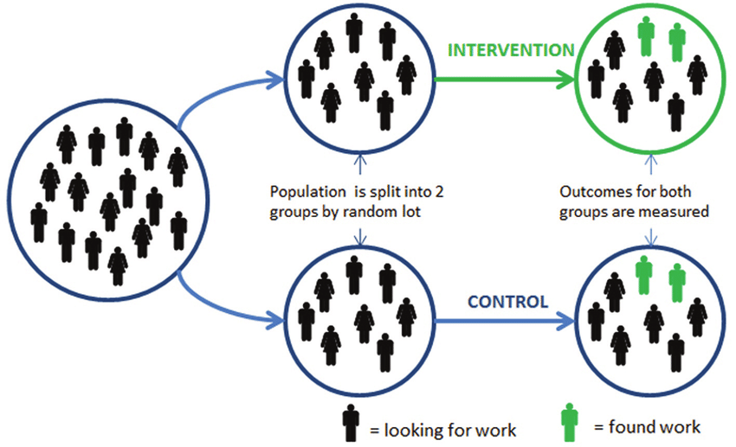
Experiments: The gold standard for causal inference

Slide 41
What is the research design in Kim’s study?

Slide 42
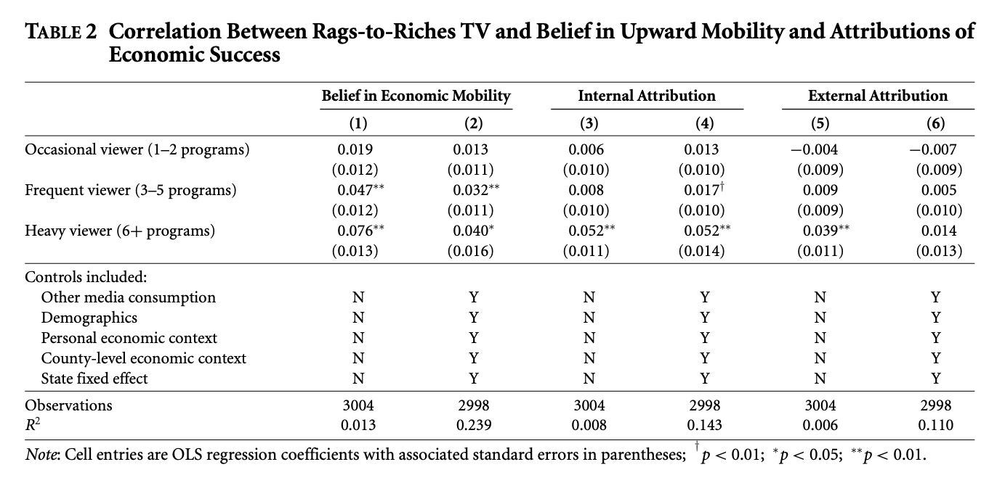
What is the research design in Kim’s study?

Slide 43
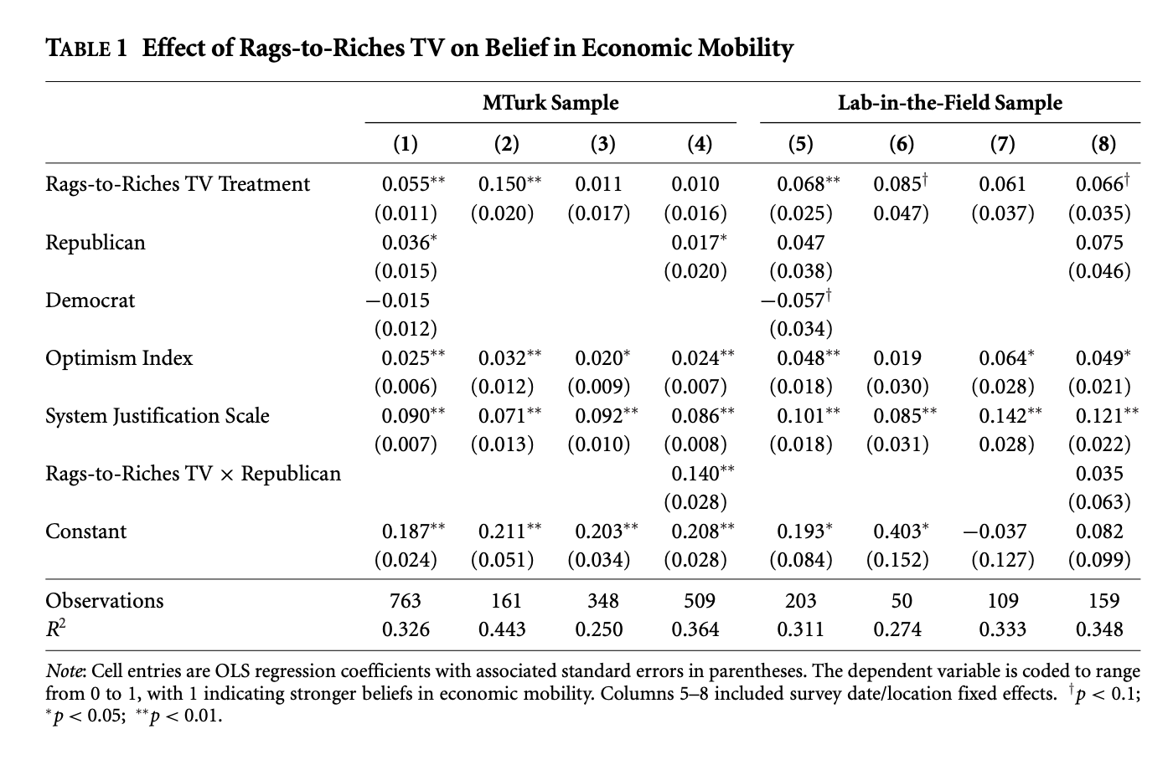
What is the research design in Kim’s study?

Slide 44
What we’ll cover today
Housekeeping
Quiz
Lecture & exercises:
What is comparative politics?
Why is comparative politics useful?
How do we learn in comparative politics?
Workshop: How to read a political science article

Slide 45
How to read an academic (CP) paper Why this workshop?
In this course (and probably in others) you will have to read multiple academic papers
Your research papers for this course should approximate, in some dimensions, an academic paper
Reading academic papers effectively is a key skill to build in college
Getting better at reading academic papers is a great way to build your ability to process large amounts of (often technical) information, which is something you’ll often do in careers beyond research too – e.g., in government, law, journalism, consulting, tech, etc.

Slide 46
How to read an academic (CP) paper What we will do in this workshop
We will discuss what academic papers are and what that implies for how to approach them as readers
We will examine the core structure of most academic papers, and how to leverage it for effective reading
We will do some practice with recent articles published in the AJPS

Slide 47
How to read an academic (CP) paper What is an academic paper?
They may seem obscure pieces of academic knowledge, but they sometimes shape policy debates, government programs
Key implication: it is critical to understand what they claim, how they support those claims, and in what ways the evidence may be weak
They present cutting-edge research on a very specific question, sometimes leveraging advanced research methods
Key implication: they often have a lot of technical details, jargon, often formulas
They are written as a defense of a theoretical and/or empirical claim; authors try to close the door to critiques
Key implication: they follow a common structure and have plenty of signposts to help the reader

Slide 48
How to read an academic (CP) paper How are academic papers structured?
Abstract – short summary
Introduction – longer summary, more details
Theory (including hypotheses, the predictions the authors seek to test)
Research design or methods (i.e., what data the authors use and how they analyze it to test their hypotheses)
Results (typically three sets of results, in order of importance: 1) main results, 2) mechanisms, 3) robustness checks)
Conclusion – summary, implications, gaps for future research

Slide 49
How to read an academic (CP) paper How are academic papers structured?
Unlike a novel or a newspaper article, academic papers have a structure that tells us from the get go what the key take-aways are
Academic papers are structured in layers, like an onion, making it easier for the reader to digest

Slide 50
How to read an academic (CP) paper Take-away tools for reading papers
Don’t be intimidated or discouraged
Exploit the core structure to your advantage
Do not pay equal attention to all parts in the paper
Put more energy in understanding the introduction, the theory, and the main results
Do not read linearly.
It is a good idea to first read the abstract and intro, then skim the rest of the paper, then go deeper into most important sections.
If you don’t understand something, go back to the bigger picture in the introduction or at the beginning of the section you are at.
Make sure you understand the (main) graphs and tables, where a lot of the message is condensed
Being able to narrate what the plots and tables show is a good test of whether you understand the paper
Leverage topic sentences
Learn to be comfortable with not understanding 100% of the paper

Slide 51
How to read an academic (CP) paper Key questions to ask of an academic paper
What is the author’s argument or thesis?
Who or what is the author arguing against?
What’s at stake?
What evidence does the author present in support of their thesis? What is the research design? What are the cases? Are those relevant?
Is the evidence convincing? Does the author present evidence about the mechanisms behind the main results?
Could there be other reasons why we see those results, other than the author’s theory being right? How does the author address those potential concerns?
Even if the result show what the author claims they show, are their conclusions / implications reasonable?

Slide 52
Register your attendance

Slide 53
How to read an academic (CP) paper Taking it all to practice
In groups of 2-5 people
Go to www.ajps.org and choose one recent AJPS article that seems interesting to you all – but make sure the article has empirics
Think through the following key questions:
What is the author’s key hypothesis?
Is the argument descriptive, predictive, causal, or normative?
In their theory, what are the key variables of interest, and how are they related?
What is the author’s research design?
Do you believe the findings or conclusions of the author are credible? Why?
Do you believe the article’s findings are relevant / useful? Why?
Submit your answers at www.tinyurl.com/gcp-w1

Slide 54
What we covered today
Housekeeping
Quiz
Lecture & exercises:
What is comparative politics?
Why is comparative politics useful?
How do we learn in comparative politics?
Workshop: How to read a political science article

Slide 55
Next steps
Next week we will be discussing the nature, formation, and development of states
Read and prepare for quiz:
Comparative politics – Chatper 4
Foundations of comparative politics – Chapter 4

